Slide 1

INFORMATION SECURITY
SafeThings: 8th Workshop on the Internet of Safe Things
Research Papers Presentation
Team:
Muhammad Tahir K214503
Insha Javed K213279
Sabika Shameel K214606

Slide 2
SafeThings: 8th Workshop on the Internet of Safe Things
Welcome to the 8th annual SafeThings workshop, focused on the Internet of Safe Things, a crucial area of research for cybersecurity professionals. The SafeThings workshop brings together researchers and practitioners from around the world to discuss emerging challenges and solutions in the field of secure and trustworthy IoT devices.

Slide 3
Research Paper 01:
Device Discovery in the Smart Home Environment

Slide 4
Introduction
The Internet of Things (IoT) has revolutionized the smart home, bringing convenience and innovation to our daily lives. However, with the increasing number of interconnected devices, safeguarding privacy becomes a critical concern.
These devices, ranging from smart speakers to door locks, enhance convenience but also raise significant privacy and security concerns.

Slide 5
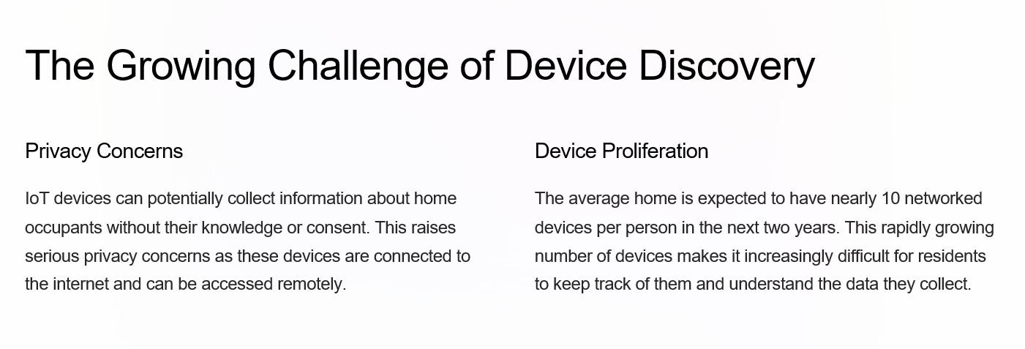

Slide 6
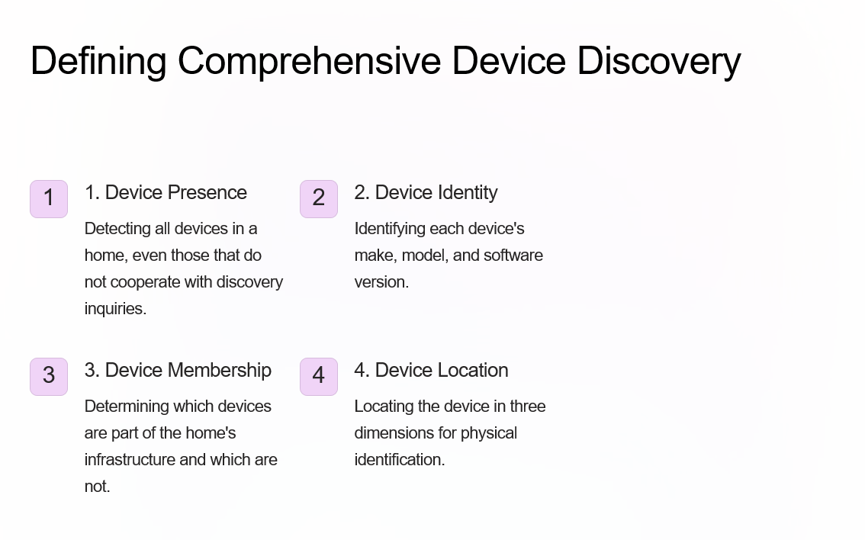

Slide 7
Findings
The paper identifies critical gaps in current smart home device discovery systems:
1. None of the evaluated technologies (FIDO, MUD, NETCONF, Matter) fully support all four facets of device discovery.
2. Localization, a critical component for device discovery, is poorly supported across all technologies.
3. Existing methods struggle to detect devices that do not actively transmit signals or use non-standard protocols.

Slide 8
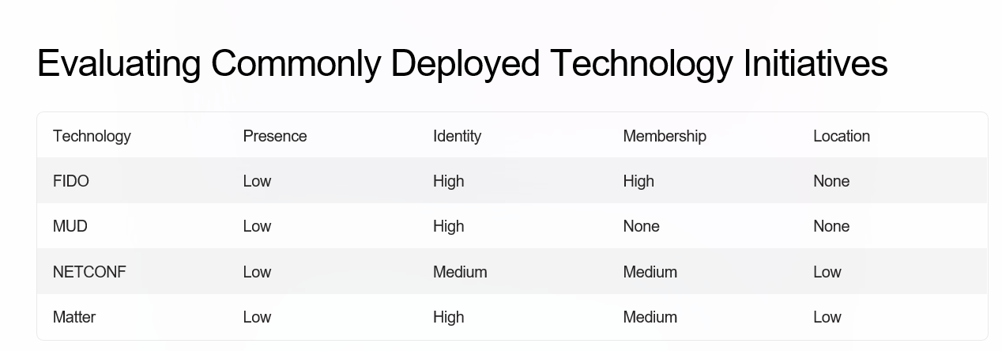

Slide 9
Continue …
Many existing protocols (like FIDO, MUD, NETCONF, and Matter) are designed with different primary goals (e.g., security, configuration, or interoperability) and do not inherently support or prioritize localization features.
The paper proposed a combined approach using MUD and NETCONF along with a localization system to address all four aspects of device discovery. This system would leverage the strengths of each technology, enabling a more complete and accurate understanding of devices in the smart home environment.

Slide 10
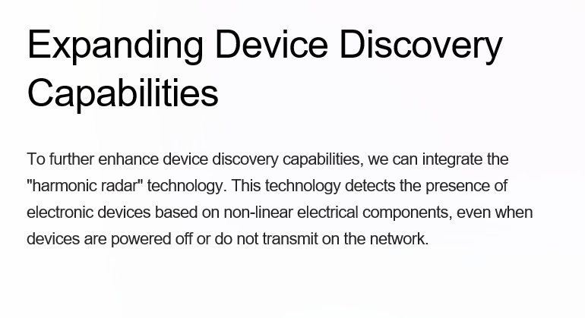

Slide 11
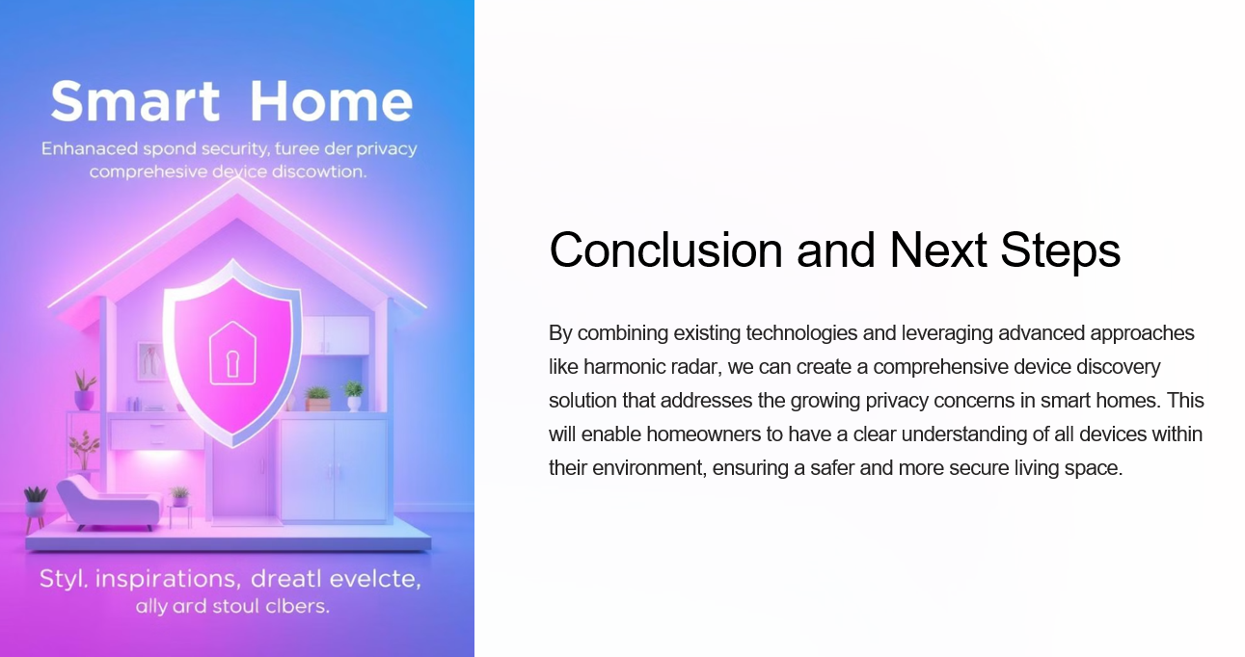

Slide 12
Research Paper 02:
Seamlessly Insecure: Uncovering Outsider Access Risks in AiDot-Controlled Matter Devices

Slide 13
Introduction
The Matter protocol has been heralded as a unifying standard for IoT device interoperability, prioritizing security and seamless user experiences. However, this paper uncovers significant vulnerabilities in AiDot-controlled Matter-enabled devices, particularly within their implementation of Device Management Channels (DMCs). These flaws allow adversaries to bypass Matter's robust security and gain unauthorized access without requiring physical device access, Wi-Fi credentials, or user knowledge. The paper highlights the critical need for improved security practices in IoT ecosystems as Matter adoption grows across critical devices like smart locks and cameras.

Slide 14
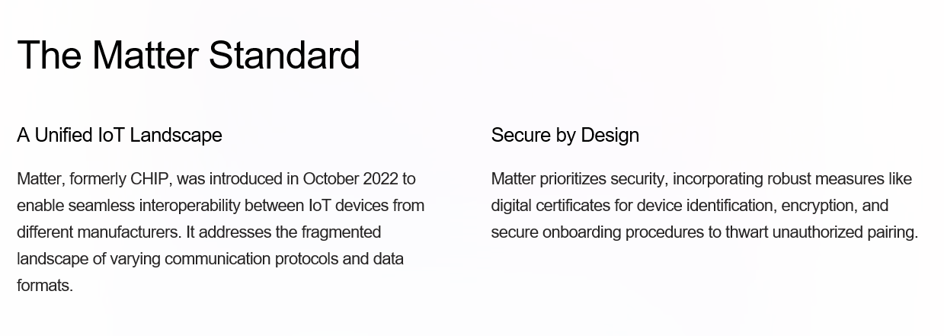
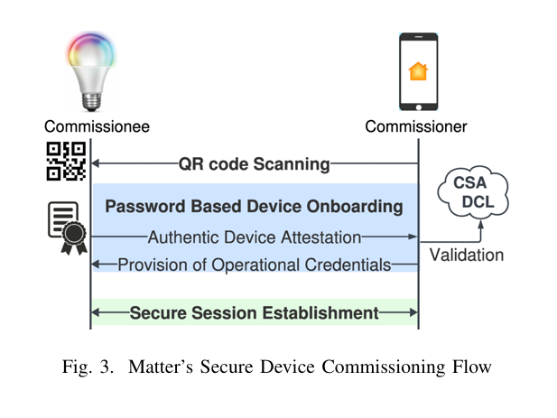
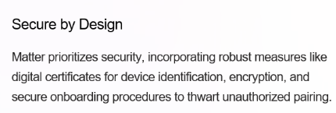

Slide 15
Objectives
1. Identify and demonstrate vulnerabilities in the implementation of Matter-enabled devices, particularly concerning unenrolled DMCs.
2. Evaluate the feasibility of unauthorized outsider access attacks on Matter devices.
3. Advocate for manufacturer-level interventions to mitigate identified security risks.
4. Extend the discussion beyond insider threats to include outsider attacks enabled by flawed implementations.

Slide 16
Methodology
1. Threat Scenario and Adversary Model: The researchers envisioned an adversary with no prior access to the smart home, its Wi-Fi credentials, or its devices. This adversary exploits unenrolled DMCs through the AiDot app.
2. Experimental Setup: Tested 15 commercially available IoT devices, including AiDot-controlled Matter devices and others from brands like TP-Link and Sengled. Simulated attack conditions from up to 30 feet away, using tools like the AiDot app to detect and pair with devices. Focused on determining the ease of unauthorized pairing and control via DMC vulnerabilities.
3. Evaluation Metrics: Devices were assessed based on their resistance to unauthorized access, considering factors like pairing prerequisites (e.g., QR code, physical access) and whether existing connections were disrupted.
4. Ethical Considerations: Experiments were conducted using owned devices, with no external devices or networks compromised.

Slide 17
Findings
1. Vulnerable Devices: 5 out of 15 Matter-enabled devices, all AiDot-controlled, were highly vulnerable to outsider access. These devices failed to close their DMCs after pairing, allowing an adversary to pair and control them via the AiDot app.
2. Resistant Devices: Non-AiDot Matter devices exhibited stronger security, often requiring physical access, QR codes, or Wi-Fi credentials to enable pairing. Some devices had securely closed pairing windows post-setup, making unauthorized access infeasible.
3. Attack Implications: Adversaries could remotely control devices, monitor activity, and retrieve sensitive network information. Potential risks include manipulation of smart locks, tampering with security cameras, and unauthorized device operation.
4. Manufacturer Oversight: The vulnerabilities stem from manufacturers failing to close pairing windows or enforce commissioning prerequisites. Rapid deployment of Matter devices without rigorous security testing exacerbates these risks

Slide 18
Strengths
1. Timely and Relevant: The study addresses critical security gaps as Matter adoption expands, offering actionable insights for improving IoT device security.
2. Clear Demonstration: Practical experiments validate the feasibility of outsider attacks, emphasizing real-world implications.
3. Focus on Outsider Threats: By shifting the focus from insider risks, the paper highlights a less-explored yet equally critical attack vector.
4. Actionable Recommendations: The proposed mitigations are realistic and directly address the identified vulnerabilities.

Slide 19
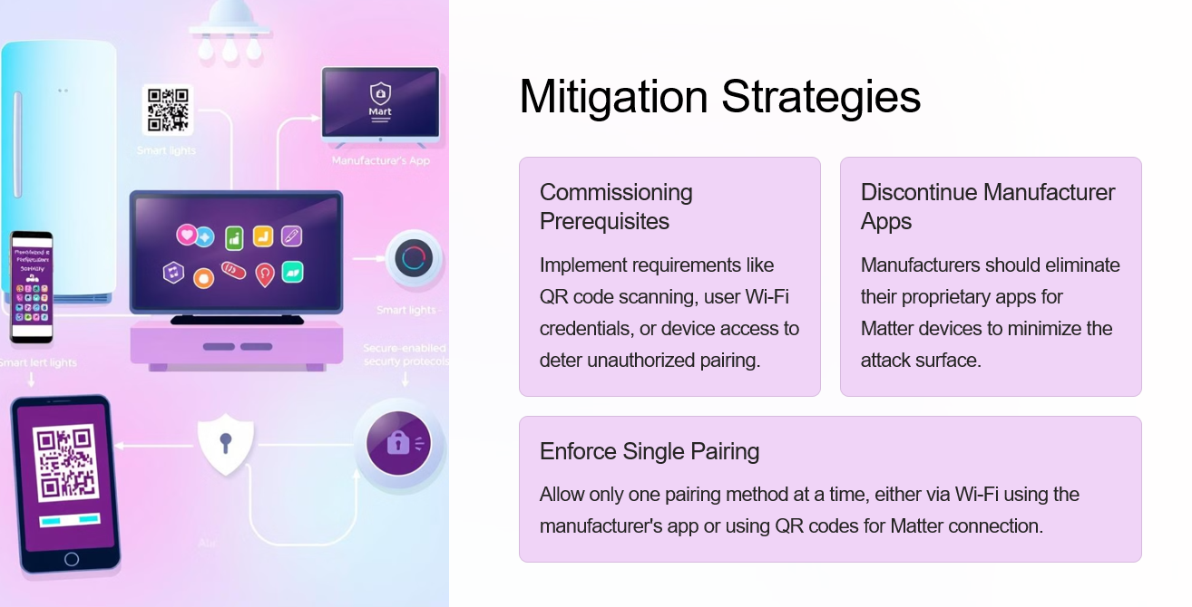
Recommendations
1. Close Pairing Windows: Ensure that DMCs are securely closed immediately after pairing to prevent unauthorized access.
2. Enforce Single Active DMC: Restrict devices to operate via a single channel (e.g., Matter over Wi-Fi or Thread) at any given time.
3. Implement Commissioning Prerequisites: o Require QR codes, physical device access, or Wi-Fi credentials for pairing. o Remove QR code stickers after setup to prevent misuse.
4. Discontinue Manufacturer Apps: Avoid using proprietary apps for Matter devices to eliminate redundant pairing options.
5. Enhanced Security Protocols: Integrate centralized access control systems like CGuard to monitor and manage DMC access.

Slide 20
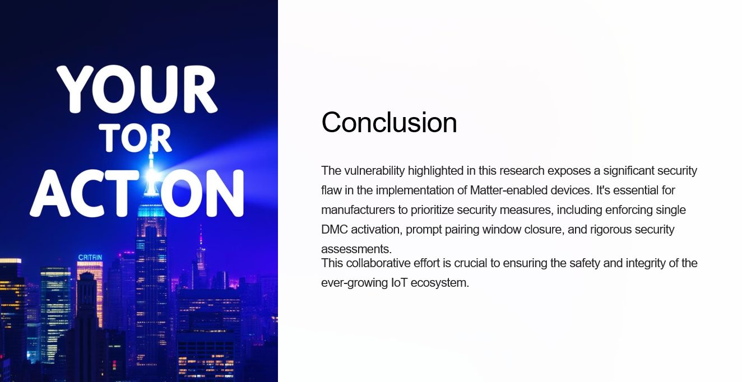

Slide 21
Research Paper 03:
Intercepting Bluetooth Traffic from Wearable Health Devices

Slide 22
Introduction
Smart wearable devices, such as blood pressure monitors, oximeters, and smartwatches, have become integral to modern health tracking and monitoring. These devices collect sensitive health data, such as blood oxygen levels, heart rate, and stress levels, which they transmit to smartphones via Bluetooth Low Energy (BLE). BLE is preferred due to its low power consumption and short-range communication capabilities, making it ideal for lightweight IoT devices.
While prior research has largely focused on passive attacks (observing traffic patterns to infer user activities), this study explores active attacks, particularly Man-in-the-Middle (MITM) and Denial-of-Service (DoS) attacks. These attacks directly disrupt or manipulate BLE communication, allowing adversaries to intercept encrypted health data or block legitimate connections. The work highlights significant vulnerabilities in widely used wearable devices, exposing the need for stronger security practices to protect user data and privacy.

Slide 23
Objectives
The study aimed to:
Identify vulnerabilities in the BLE implementations of popular wearable health devices.
Assess the feasibility of MITM and DoS attacks in extracting or disrupting sensitive health data.
Analyze BLE security mechanisms and identify gaps in their application.
Provide recommendations for mitigating security risks and enhancing BLE implementations to safeguard user privacy.

Slide 24
Methodology
Device Selection
A diverse set of popular health-related devices was chosen for testing, including:
Smartwatches: Apple Watch, Fitbit.
Health Monitors: Oximeters, blood pressure monitors, stress level monitors.
Scales: Body weight and body fat scales.
Criteria for selection:
Devices widely used in the market and manufactured by well-known brands.
Devices incorporating BLE or BLE/Wi-Fi capabilities.
Devices with good customer ratings (3.5 stars or above).
Data Collection
The study utilized the GATTacker tool, which enables MITM attacks by simulating fake BLE central and peripheral devices. The setup involved:
Hardware: Two Raspberry Pi devices equipped with BLE dongles.
Software: GATTacker implemented using Noble and Bleno libraries for data interception.

Slide 25
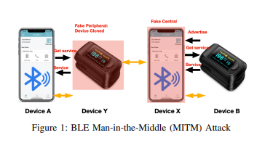
Attack Execution
Denial-of-Service (DoS) Attacks:
Fake central devices connected to peripherals, preventing legitimate smartphones from pairing.
Exploited BLE's limitation of single central-peripheral connections.
2. Data Interception: because the fake devices establish connections directly with the device and the phone, they can observe data content inside the encrypted packets.
Man-in-the-Middle (MITM):creates separate connections with the device and the phone, respectively. Consequently, both the device and the phone mistakenly believe that they are talking to each other directly. The MITM attacker can then observe all data sent by the device, and even inject or alter the data before forwarding them to the phone. MITM Tool. We use the GATTacker tool.
Fake central (X) advertises its presence and collects service information from
the Oximeter (B).
Fake central (X) connects with fake peripheral (Y) via HTTP
Proxy and sends cloned information to Y.
Fake peripheral (Y) connects to the real central (A), using the cloned data,
and tricks A into believing Y is the real Oximeter.
Fake central (X) connects to the Oximeter (B), impersonating the real phone.
Both A and B believe they are connected, allowing them to exchange data, which is captured by X and Y.

Slide 26
Findings
Denial-of-Service (DoS):
All tested devices were found vulnerable to DoS attacks.
Attacks successfully blocked legitimate central devices from connecting to peripherals.
Data Interception:
Several devices leaked sensitive health data, even with encrypted communication.
Example: Decoded blood oxygen levels and pulse rates from intercepted packets.
BLE Implementation Gaps:
MAC Address Randomization:
Many devices failed to renew MAC addresses frequently, exposing them to tracking.
Static identifiers in advertising packets further undermined privacy.
Poor Pairing Mechanisms:
Most devices relied on insecure methods like “Just Works,” which lacks authentication and is vulnerable to MITM attacks.

Slide 27
BLE Security Mechanisms
1.10.1 Pairing Mechanisms
Legacy Pairing (BLE 4.0, 4.1):
Uses Temporary Keys (TK) to generate Short Term Keys (STK).
Vulnerable to brute-force attacks due to weak or hardcoded TKs.
Secure Connections (BLE 4.2+):
Utilizes Elliptic Curve Diffie-Hellman (ECDH) for Long Term Keys (LTK), offering stronger encryption.
Still vulnerable if authentication is poorly implemented.
Pairing Methods:
Just Works: No user authentication; easy to deploy but highly susceptible to MITM attacks.
Passkey Entry: User inputs a passkey; adds security but can be brute-forced if intercepted.
Out-of-Band (OOB): Secure via external channels (e.g., NFC) but requires additional hardware.
Numeric Comparison: Displays matching numbers for user confirmation; highly secure but needs input/output capabilities.

Slide 28
Strengths
Comprehensive Evaluation:
Provided detailed insights into active BLE attacks, complementing existing research on passive attacks.
Practical Approach:
Demonstrated real-world vulnerabilities using widely available devices and tools (e.g., GATTacker).
Highlighting Security Gaps:
Identified specific weaknesses in pairing mechanisms and MAC address randomization practices, offering actionable insights.

Slide 29
Limitations
Device Scope:
Findings are limited to the specific devices tested; results may not generalize to all BLE-enabled devices.
Focus on Active Attacks:
Did not explore other potential vulnerabilities, such as hardware flaws or application-level weaknesses.
Proximity Requirement:
Active attacks require the attacker to be within Bluetooth communication range, limiting scalability.

Slide 30
Research Paper 04:
Security Analysis of Wearable Smart Health Devices and Their Companion Apps

Slide 31
Introduction
Wearable Smart Health Devices (WSHDs) are physical devices equipped with sensors to monitor health and connect to the internet for data exchange. These devices have rapidly spread across sectors, helping users track fitness and health while also transforming industries by increasing efficiency and reducing costs. However, the fast-paced development of WSHDs often leads to security being overlooked, resulting in vulnerabilities that make them susceptible to attacks and data leakage.
Typically, WSHDs communicate with a mobile companion app via Bluetooth Low Energy (BLE), which allows users to control the device and manage settings. The mobile application pairs and bonds with the WSHD to establish a communication channel to send and receive data. The mobile companion app plays a critical role in the WSHD system, as it has access to the user’s sensitive data. While BLE conserves battery, the limited resources of these devices often hinder the security of their communications.
This study focuses on identifying security risks in WSHDs and their companion apps.

Slide 32
Objectives
Reverse-engineer companion apps of various wearable smart health devices (WSHDs) to investigate their communication protocols and security implementations.
Analyze the communication between the WSHD, their companion app, and the cloud, revealing insecure data handling and personal information leakage.
Identify security flaws in companion apps and WSHD devices, uncovering exposed keys, API endpoint information, and encryption schemes that can be exploited to access backend servers.
Demonstrate potential attack scenarios based on discovered vulnerabilities and propose security improvements.

Slide 33
METHODOLOGY
Methodology:
Design Overview: Focuses on Android apps. The process includes reverse-engineering the apps, conducting static analysis, and using dynamic analysis tools like Logcat and proxy analysis.
App Collection: Five popular WSHDs (e.g., Fitbit Alta, Garmin Forerunner 45) were analyzed, along with their companion apps.
Implementation: Decompiling APK files, examining the source code, and performing security audits using tools like Apktool and JADX.
App Analysis: Conducted static and dynamic analyses to identify vulnerabilities, including insecure API keys, poor encryption, and sensitive data exposure.

Slide 34
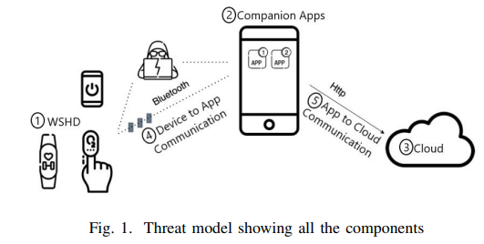
App Analysis: Conducted static and dynamic analyses to identify vulnerabilities, including insecure API keys, poor encryption, and sensitive data exposure.
1. Static Analysis
What it is: Reviewing the app’s code without running it to find potential security flaws.
Reverse engineering: The APK is decompiled using tools like Apktool and JADX.
Code inspection: Researchers search for exposed API keys, hardcoded passwords, and unencrypted sensitive data.
Purpose: Detect flaws such as weak encryption or improper storage of sensitive information before the app runs.
2. Dynamic Analysis
What it is: Running the app to observe its real-time behavior and interactions with external systems.
Logcat: Logs internal data leaks, including authentication tokens and API responses.
Proxy analysis: A proxy server like Burp Suite intercepts and analyzes communication between the app and the server to detect insecure data transmission.
Purpose: Identify vulnerabilities that appear only during execution, such as insecure transmissions or server communication flaws.

Slide 35
Findings
Common Issues:
Unencrypted BLE traffic in some devices.
Hardcoded API keys and tokens in app code.
Weak encryption schemes (e.g., MD5).
Logcat leaks exposing sensitive data, such as user IDs and callback information.

Slide 36
Strengths
1. Comprehensive Methodology:
The use of reverse engineering and real-world testing provides robust insights into vulnerabilities.
Ethical considerations ensure responsible research practices.
2. Significant Contributions:
Highlights common flaws in encryption and API management across health related apps.
Identifies inconsistencies in security implementations among WSHDs.

Slide 37
Recommendations
Enhance App Security:
Avoid hardcoding API keys; dynamically retrieve them from secure servers.
Improve BLE Communication:
Encrypt all BLE traffic using robust algorithms (e.g., AES).
Require user confirmation for all BLE connections and attribute updates.
Secure API Endpoints:
Use modern encryption schemes (e.g., AES-256) for data transmission.
Enforce strict certificate pinning to prevent TLS spoofing.
Prevent Data Leaks:
Disable sensitive logging (e.g., Logcat).
Avoid exposing user information in logs or callbacks.

Slide 38
Research Paper 05:
Virtual Key Mysteries Unveiled: Detecting Keystrokes in VR with External Side-Channels
Subtitle: Understanding Security Challenges in AR/VR

Slide 39
What is the Research about?
The paper explores a novel security risk in Virtual Reality (VR) environments. It introduces a method called LensHack, where an external attacker can infer sensitive information, like typed passwords, from VR users. This is done by observing users’ physical movements with a camera, rather than hacking the VR device itself.
While many studies focus on internal threats (malicious apps, compromised sensors), this paper highlights an external attack where an outsider, using an external camera, can steal sensitive information.

Slide 40
How LensHack Works
External Observation: Unlike typical cyber attacks that involve hacking software or hardware, LensHack uses an external camera (like a security camera or a hidden device) to monitor a VR user’s hand movements as they type on a virtual keyboard.
Keystroke Detection:
The attacker analyzes video frames using a six-step algorithm.
It tracks hand and body movements, identifies when keys are pressed, and estimates the virtual keyboard's position.
The tool adjusts its predictions dynamically to improve accuracy.

Slide 41
Tools Used:
MediaPipe: A machine learning framework that tracks hand and body points in video frames.
Machine Learning: The system uses a neural network to predict the keyboard’s location and improve keystroke accuracy.

Slide 42
Findings
Achieved 80% accuracy in detecting keystrokes.
Accuracy improves with more observations (e.g., 5-10 characters).
Works in various configurations: different angles, distances, and users.
Highlights vulnerabilities of AR/VR setups in public or semi-private spaces.

Slide 43
Future Trends and Directions
Enhanced Detection: Improved AI models to detect attacks like LensHack.
Secure Design: AR/VR devices must incorporate physical security measures.
User Awareness: Educating users about potential side-channel vulnerabilities.
Research Needs: Explore defenses against external attacks like motion obscuration or keyboard randomization.

Slide 44
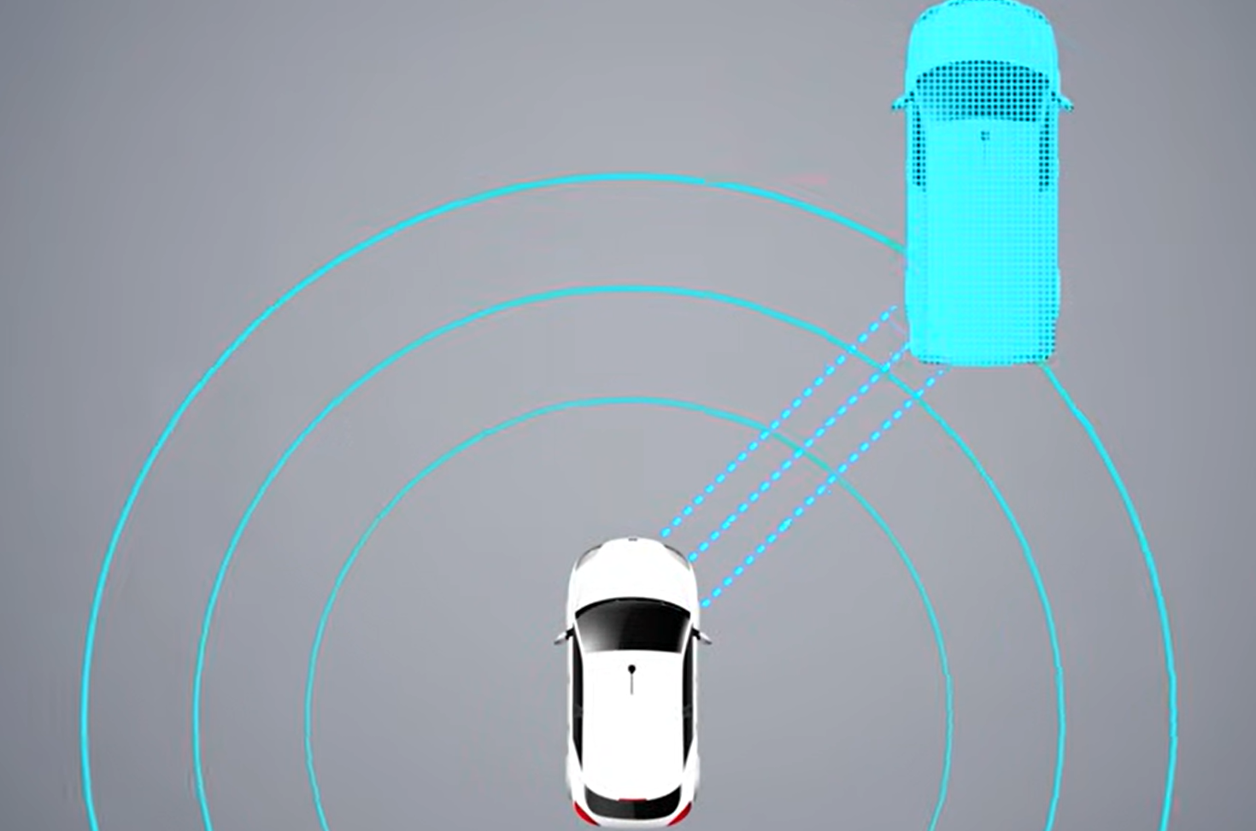
Research Paper 06:
Adversarial 3D Virtual Patches using Integrated Gradients
Subtitle: LiDAR Security in Autonomous Driving

Slide 45

What is the Research Paper About?
This research focuses on LiDAR spoofing attacks—a method used to confuse autonomous vehicle sensors by injecting false data into their 3D environment. The authors propose a more efficient way to hide real objects from LiDAR-based 3D detectors by introducing Virtual Patches (VPs) that target smaller, critical areas in the LiDAR data instead of the whole scene.The findings underline the need for stronger security measures in autonomous vehicle technology.

Slide 46
What Are Virtual Patches (VPs)?
Virtual Patches (VPs) are specific, focused areas within a 3D environment (like a LiDAR point cloud) where attackers manipulate data to hide or alter objects detected by autonomous vehicles. Instead of attacking an entire object or scene, VPs target small, critical regions to reduce the attack's complexity and increase stealth.

Slide 47
How Virtual Patches Work?
Definition: Subregions in LiDAR point clouds targeted for spoofing.
VP-LiDAR Framework:
Extracts target regions from LiDAR data.
Defines manual or critical patches for spoofing.
Perturbs points within patches to deceive object detectors.
Types of VPs:
Manual Virtual Patches (MVPs): These are predefined areas, like the edges or center of an object.
Critical Virtual Patches (CVPs): These are more advanced and are generated automatically using a method called Saliency-LiDAR (SALL)

Slide 48
Results
Manual Virtual Patches (MVP): achieved 91% attack success with smaller spoofing areas.
Critical Virtual Patches:
15% more effective than MVPs.
Reduced spoofing areas by up to 50% for cars.
Universal saliency maps highlighted edges and surfaces as critical regions.

Slide 49
Why LiDAR Security Matters
LiDAR is vital for autonomous vehicles to detect objects like cars, pedestrians, and cyclists.
LiDAR spoofing can:
Create "ghost objects" to mislead detectors.
Hide real objects, potentially causing accidents.
Reducing spoofing areas improves attack stealth and reduces complexity.

Slide 50
Future Directions
Extend CVP attacks to other objects (e.g., pedestrians, cyclists).
Test physical realizability of these attacks.
Develop countermeasures like spoofing-resistant LiDAR systems.

